Slide 1
New York City Taxi Trip Duration
Team 14

Slide 2
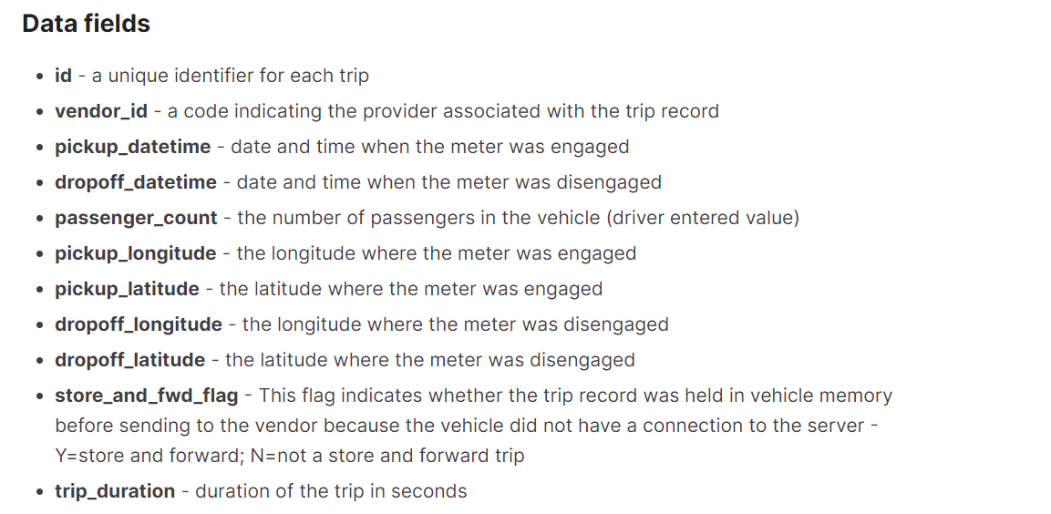
Problem Statement
Build a model that predicts the total ride duration of taxi trips in NYC
dataset released by the NYC Taxi and Limousine Commission
What kind of Machine Learning Models to implement
Supervised vs Unsupervised
Classification vs Regression
What kind of challenges does the dataset present?
Over one million training rows
Feature-engineering

Slide 3
Before Building the Model
Understanding the Data
Exploratory Data Analysis
Individual Features Visualization
Unsupervised Model
K-Means Clustering

Slide 4
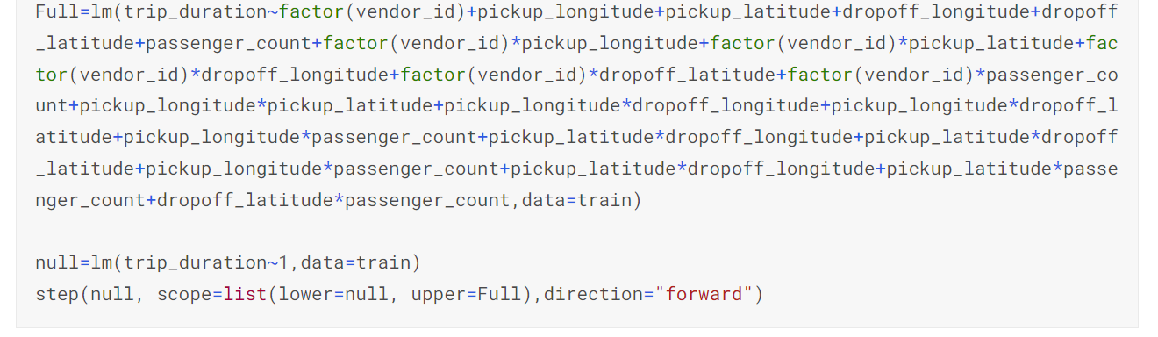
Critiques
Data limitations
Most models used the variables as given, instead of converting variables or expanding them into several features
Many used linear regression which has less explanatory power than XGBoost or Random Forests
Computationally intensive & slow
https://www.kaggle.com/code/chinki/multiple-regression

Slide 5
Random Forest Model
Robustness: Random Forest models are robust to overfitting and can handle noisy datasets
Non-parametric: Random Forest models are non-parametric -> do not make any assumptions about the distribution of the data -> this makes them more flexible
Code demo

Slide 6
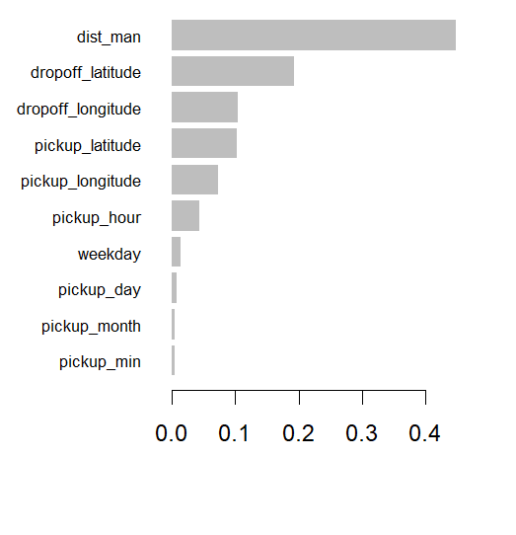
XGBoost Model
XG Boost – optimized
Combination of gradient descent opt and regularization techniques
Handles large datasets and fast training/prediction
Parallel processing
Accuracy and feature importance
Creating the model
Feature engineering
Manhattan distance, datetimes
DMatrix for large datasets
Regression model - XGBoost Demo

Slide 7
Wrap-up & Further Applications
Best approach
Exploratory data analysis and visualization with model
XGBoost – especially large data sets
Output is id's and predicted duration
Reproducibility
Complexity: using XGBoost, Dataset: train and test split, Claim: distance is biggest predictor
Hyperparameter tuning, Performance indicator: rmse
Unsupervised vs supervised
Implementing clusters
Including external data

